Slide 1

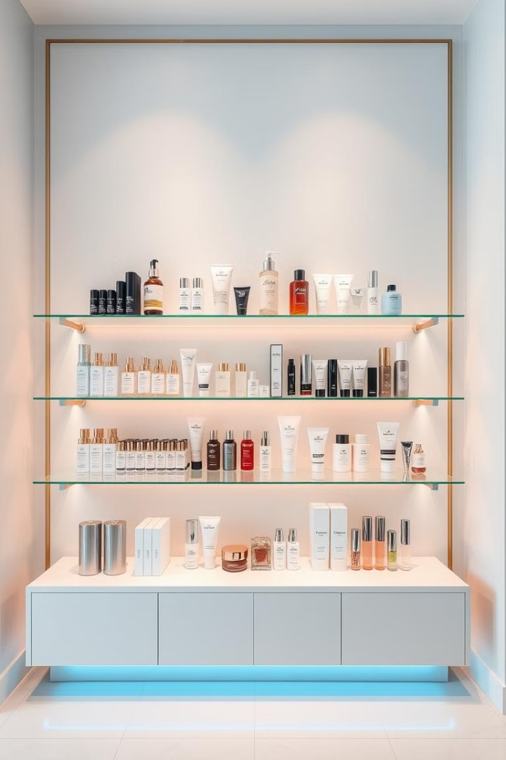

Streamlining Cosmetics with Oracle ERP
Explore how Oracle ERP can revolutionize the cosmetics industry. Discover the transition from manual processes to automated efficiency. See how ERP improves overall operations.

Slide 2
Group Team work
CEO
Shimaa Rabiea AbdElzaher
Inventory
Hady Mohammed Abdalsalam
Sabreen Shawky Hussien
Purchasing
Mohammad Rashad AboulWafa
Order Management
Ahmad Mohamad Yassen

Slide 3

Cosmetics: Challenges and Opportunities
Competitive Market
Regulatory Compliance
Complex Supply Chains
A fast-paced market with over $400B globally in 2024. Projecting $500B by 2027.
Stringent regulations like FDA and EU Cosmetics Regulation 1223/2009 must be followed.
Raw material sourcing, manufacturing, and distribution present logistical hurdles.

Slide 4

Manual ERP Processes: A Pain Point
1
Inventory Management
2
Order Management
3
Financial Accounting
Spreadsheets lead to stockouts. Inaccurate manual forecasting is common. High error rates. Poor visibility
Manual entry causes errors. Order processing can take 3-5 days. Long lead times. Inaccurate Data about Inventory Stock
Manual journal entries create reconciliation challenges. Reporting delays occur.

Slide 5




Oracle ERP: A Solution for Automation
Integrated Financials ensure accurate accounting.
Efficient Supply Chain Management streamlines logistics.
Optimized Order Management improves Sales.

Slide 6
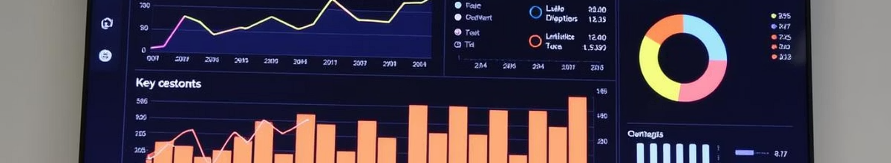
Project Goals & Objectives
Centralize Processes
Cost Reduction
Improve business efficiency with integrated management.
Cut inventory costs by 15% within 12 months.
Order Fulfillment
Automation
Accelerate delivery speed by 20% for customer satisfaction.
Enhance purchasing through seamless automation.

Slide 7





Key Automation Benefits in Cosmetics
Inventory Management
Real-time tracking cuts inventory costs by 25%.
Order Management
Automated processing reduces errors and increases speed.
Financial Accounting
Faster reconciliation offers accurate reporting.
Supply Chain
Real-time visibility reduces lead times and lowers costs.

Slide 8
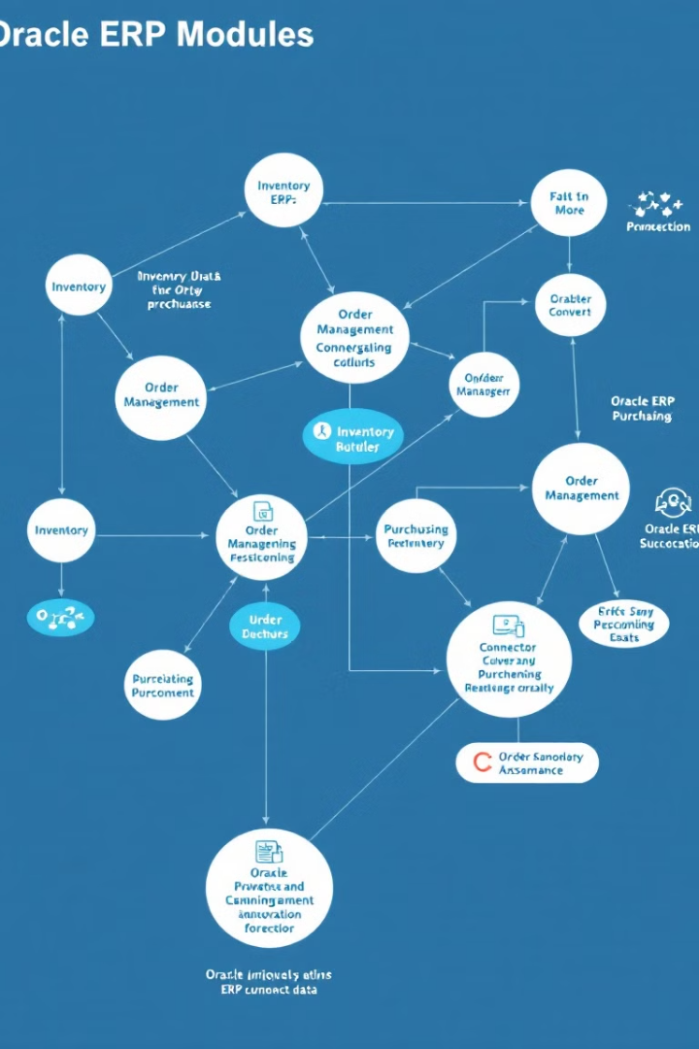
Oracle ERP Solution Overview
1
Inventory Management
Real-time visibility and optimized stock levels reduce obsolescence. Minimize waste by 15-20% with effective tracking.
2
Purchasing Management
Streamlined procurement and vendor management control costs. Clear comparison between Quotes enhances PO creation to cut costs by 10-15%.
3
Order Management
Efficient processing improves customer satisfaction and increases sales. Achieve 20% faster fulfillment times with total
40% order time reduction

Slide 9
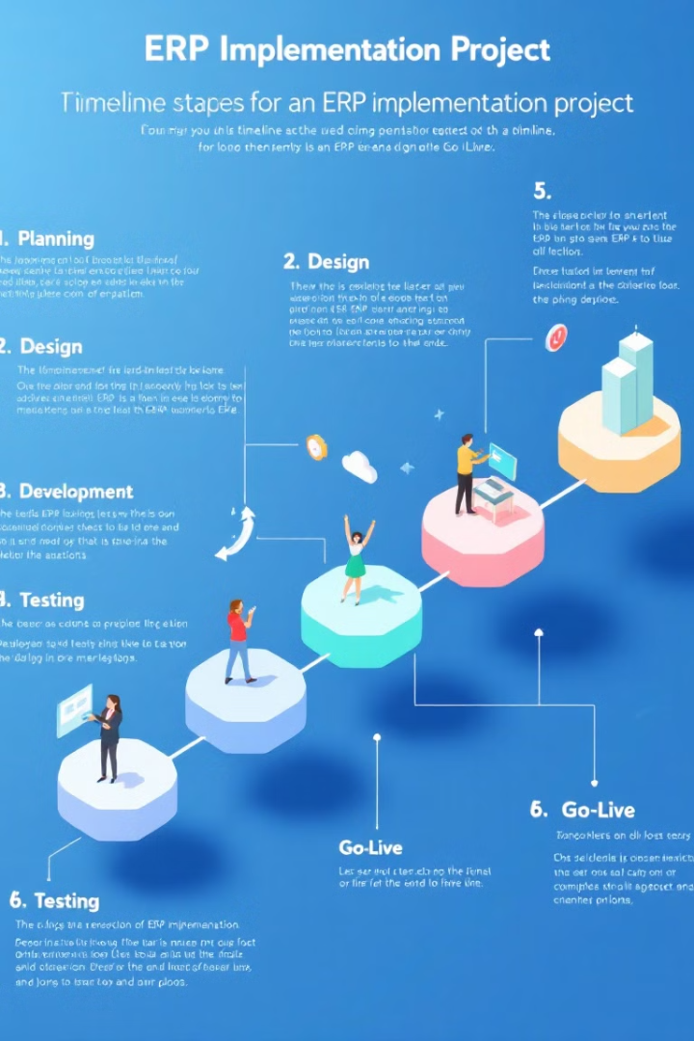
Detailed Implementation Roadmap
1
Project Initiation
scope, objectives, and KPIs in weeks 1-4. Reduce inventory costs and improve order time.
2
System Design
Configure modules based on requirements in weeks 5-12. Develop reports for real-time visibility.
3
Data Migration
Extract, cleanse data from legacy systems during weeks 13-16. Conduct rigorous system testing.
4
Training & Deployment
Develop training materials and deploy system in weeks 17-20. Provide ongoing support for users.

Slide 10
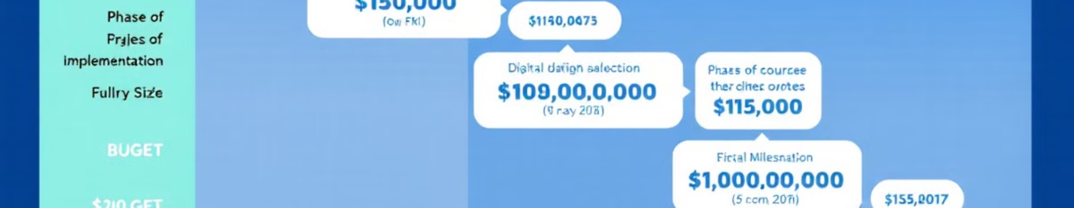
Project Timeline and Budget
20
$10,000
20%
Weeks
Budget
Payment
Estimated project duration.
Detailed breakdown is avilable.
Initial payment upon signing.

Slide 11
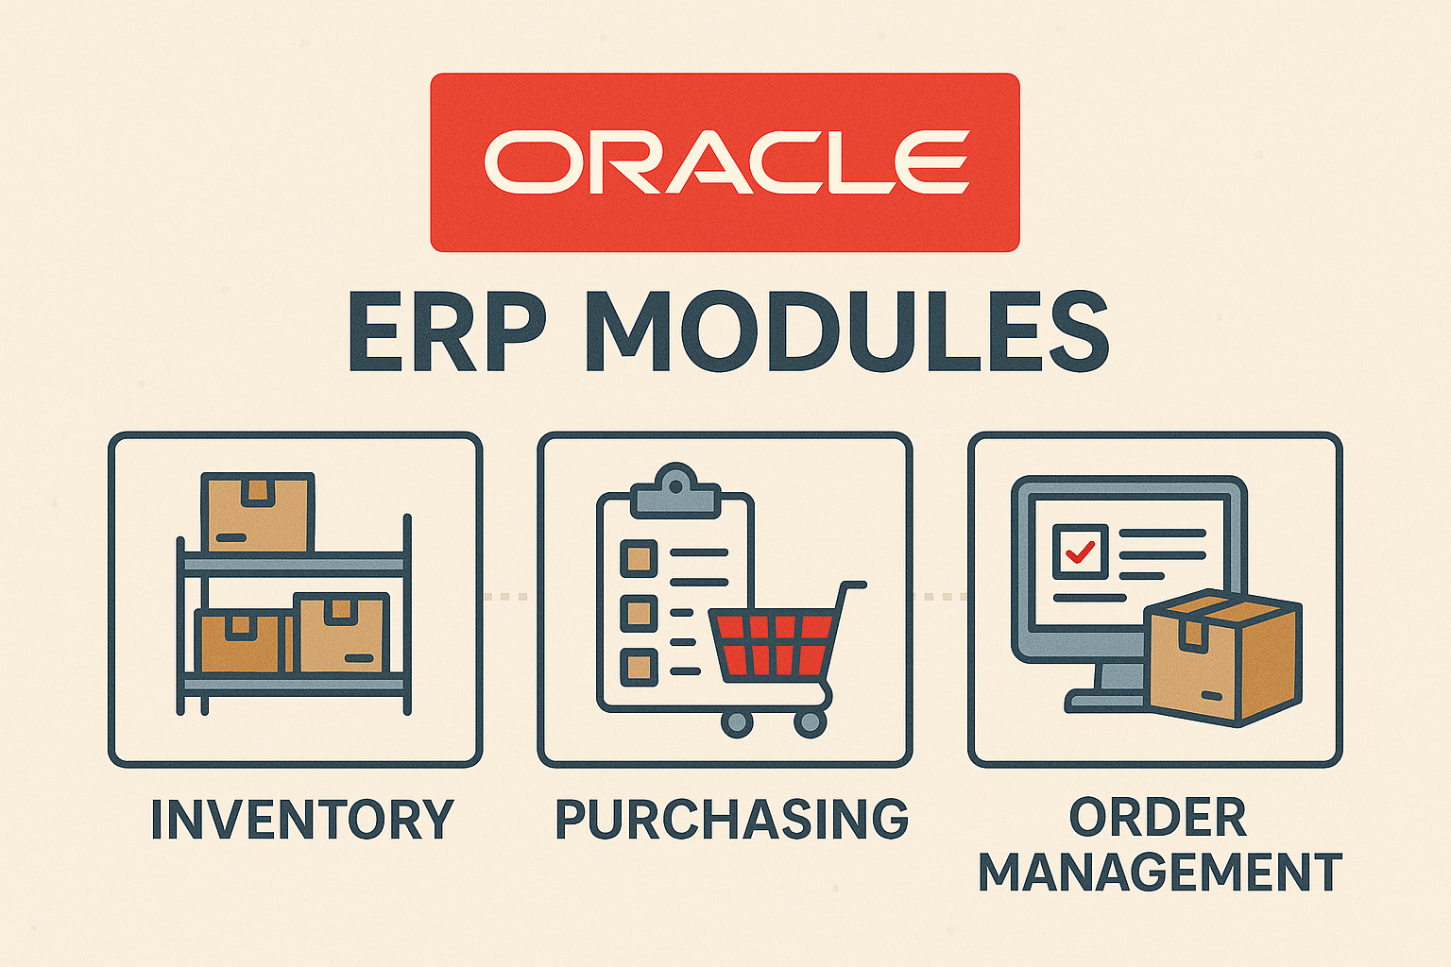
Action Plan for implementation
Implementing an ERP (Enterprise Resource Planning) system like Oracle in the cosmetics industry is a transformative move that enhances efficiency, streamlines operations, and drives business growth.
The goal is to leverage Oracle ERP’s capabilities to optimize inventory tracking, enhance production workflows, improve customer interactions, and ensure compliance and fulfilment to orders.

Slide 12
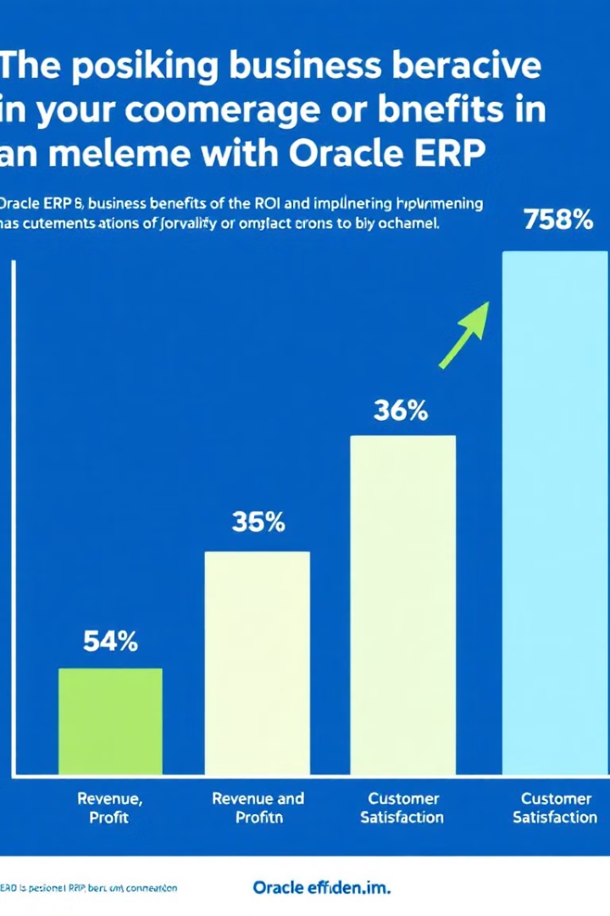
The position business perspective in your commerce or benefits in an environment with Oracle ERP.
Expected ROI and Business Benefits
75%
Inventory Reduction
15-20% decrease in holding costs.
36%
Purchasing Savings
10-15% reduction in expenses.
35%
Fulfillment Improvement
24%
20% faster order processing.
Compliance
Reduced risk of fines and penalties.

Slide 13

Oracle Inventory Management
Real-time Visibility
Track inventory across locations instantly.
Demand Forecasting
Plan stock needs using predictive analytics.
Cycle Counting
Manage physical inventory efficiently.
Warehouse Integration
Connect smoothly with warehouse management systems.

Slide 14
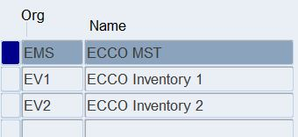
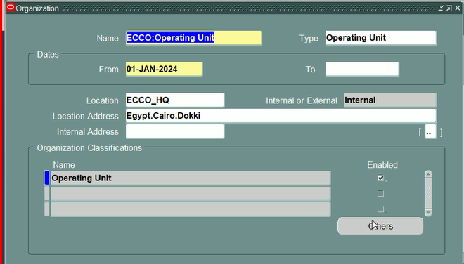
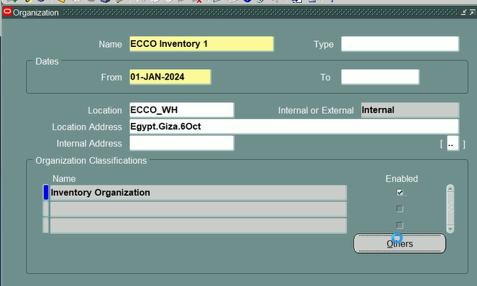
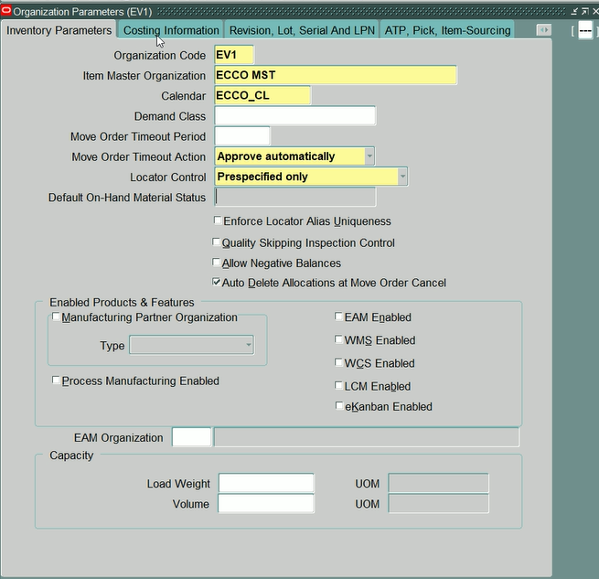

Slide 15
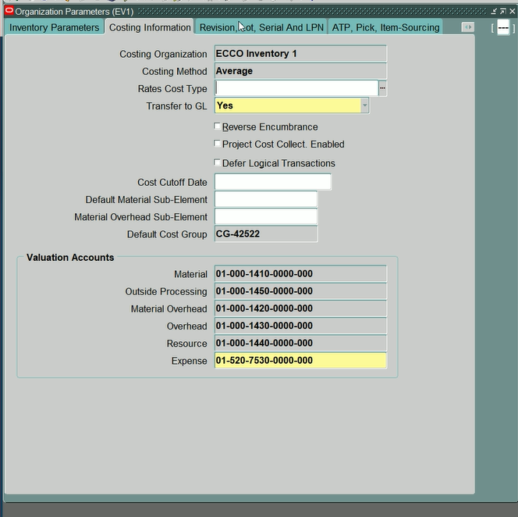
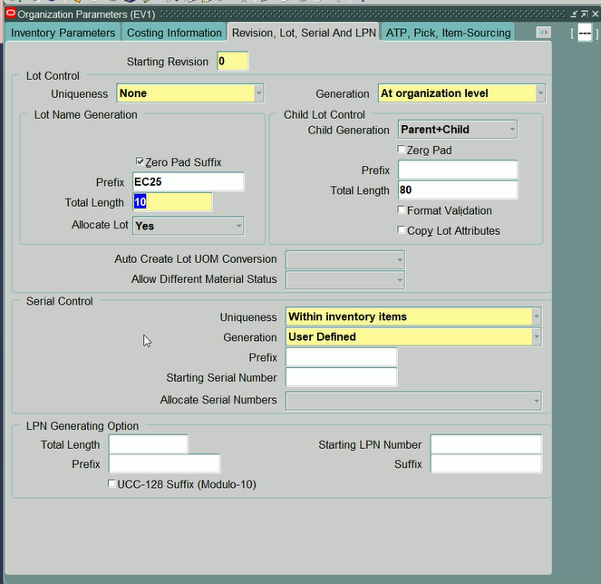
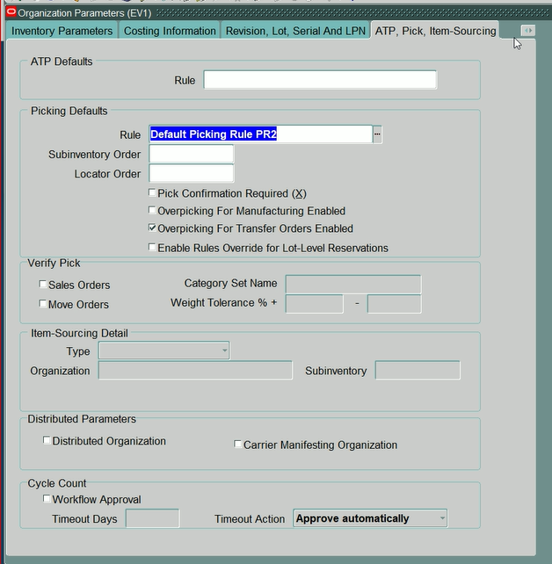
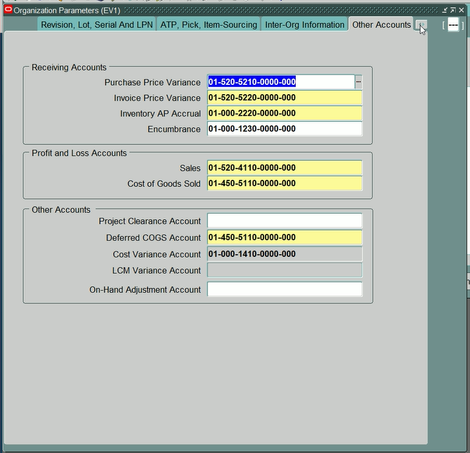

Slide 16
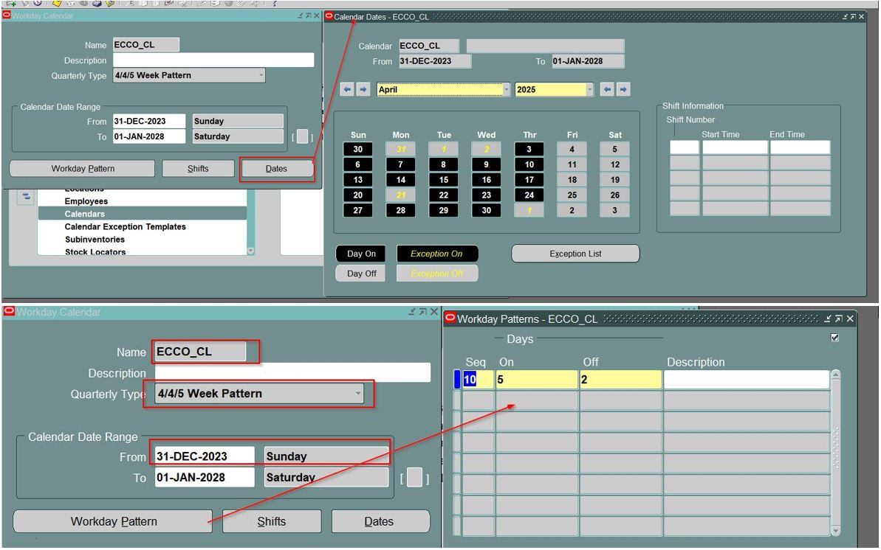

Slide 17
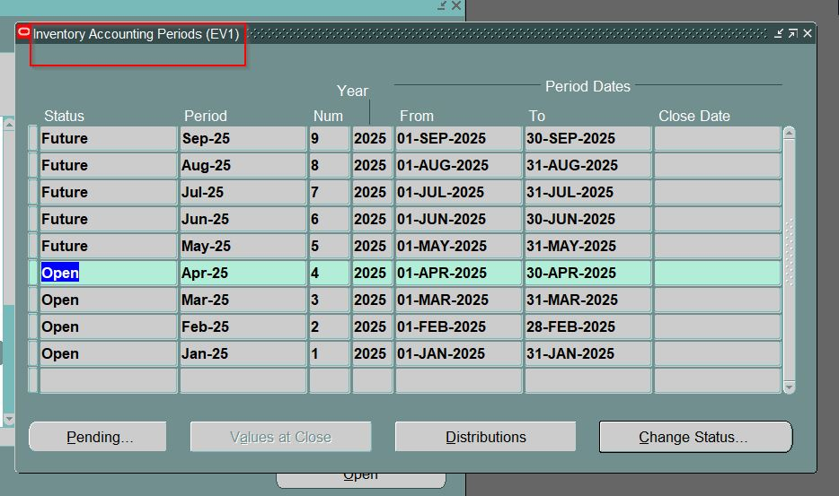

Slide 18
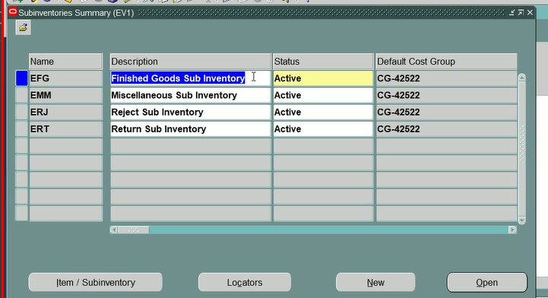
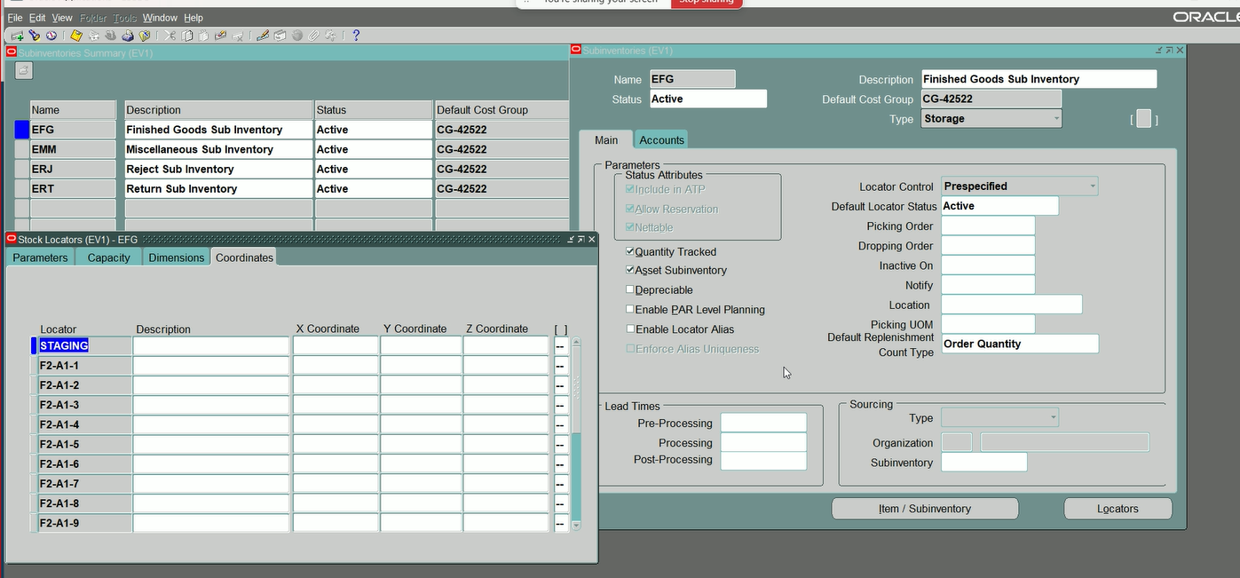
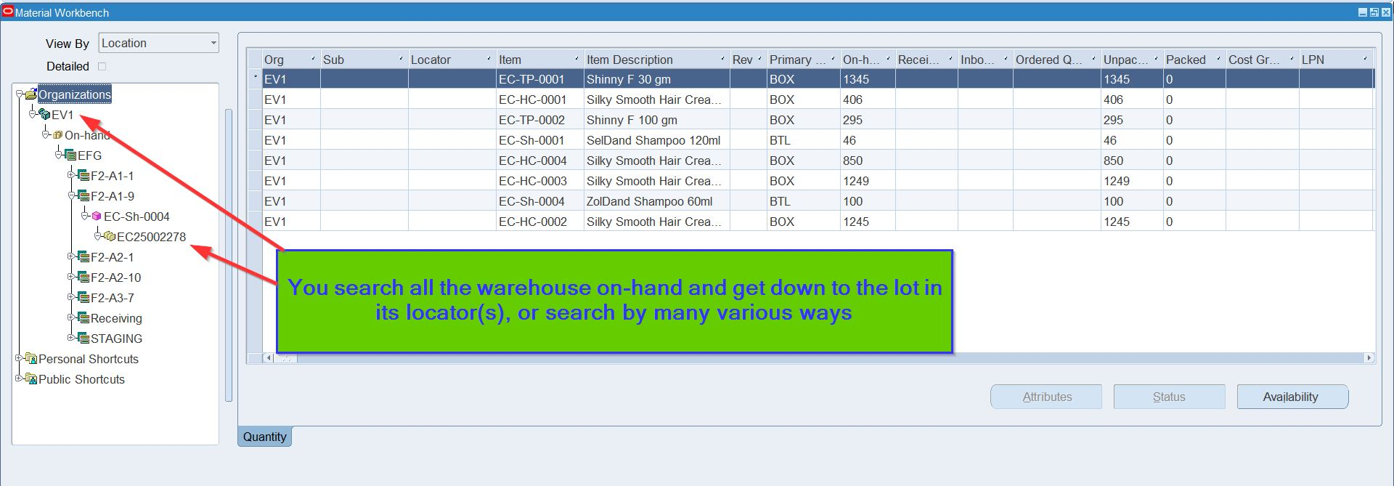

Slide 19
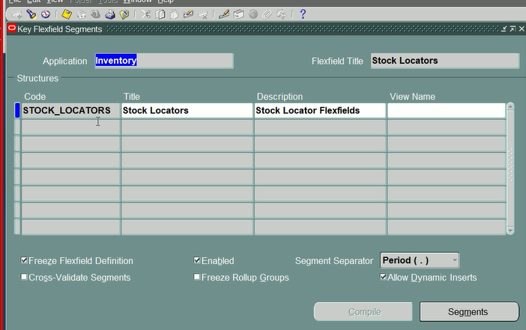
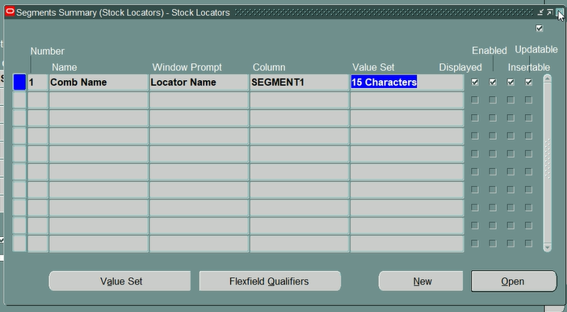

Slide 20
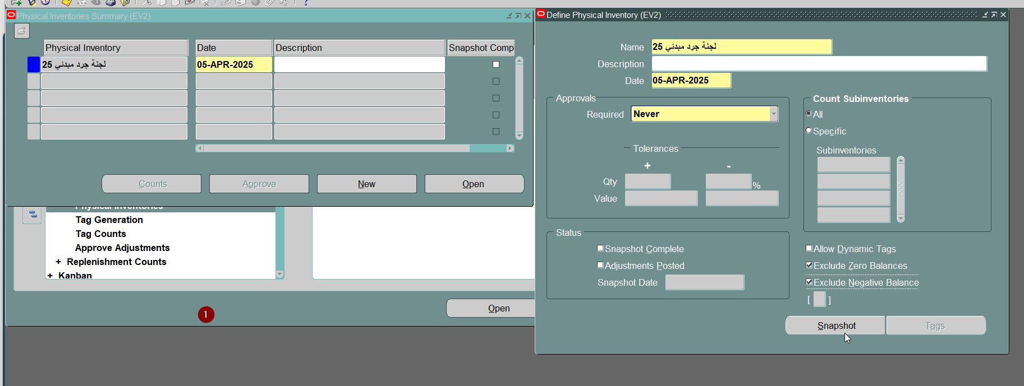
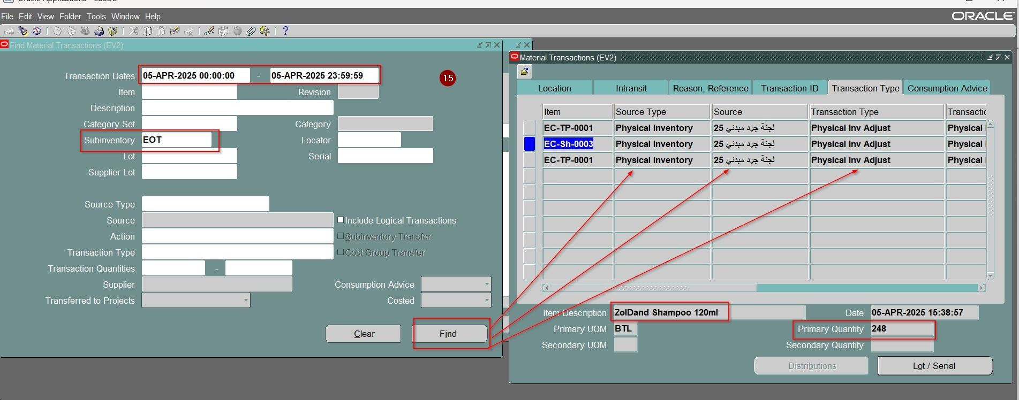
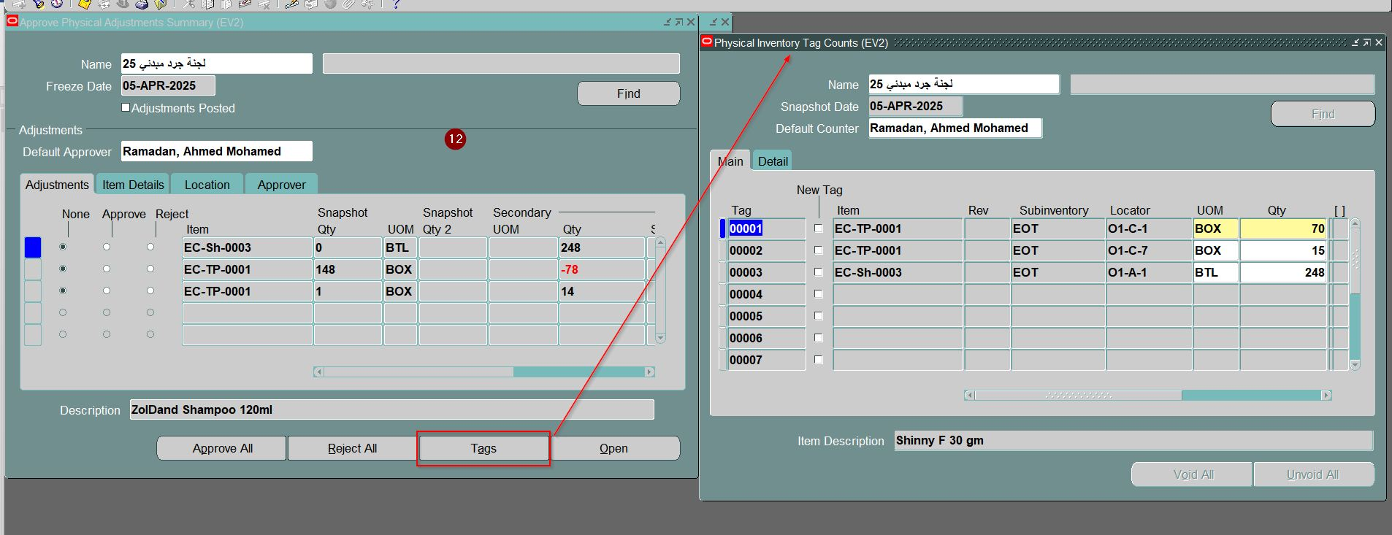

Slide 21
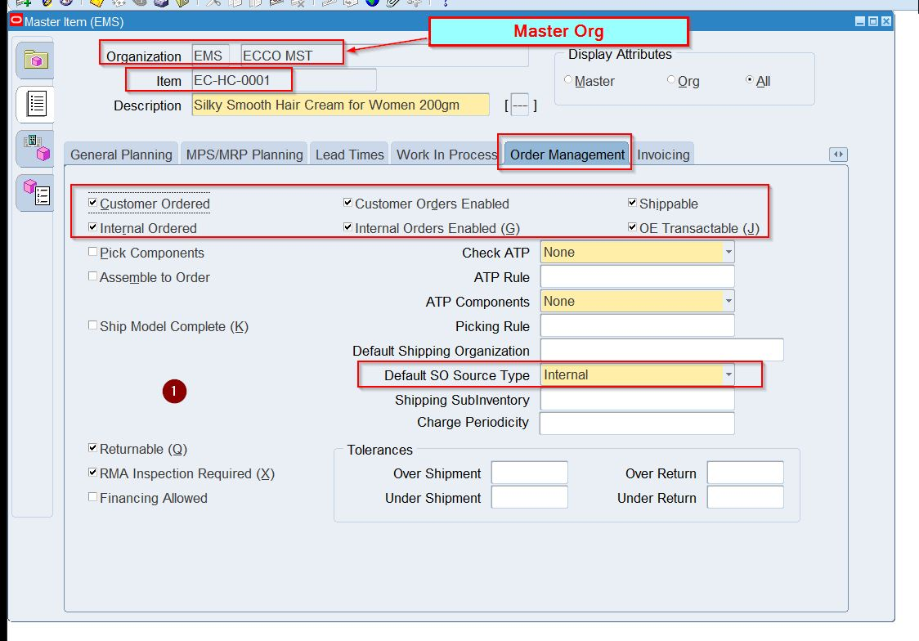
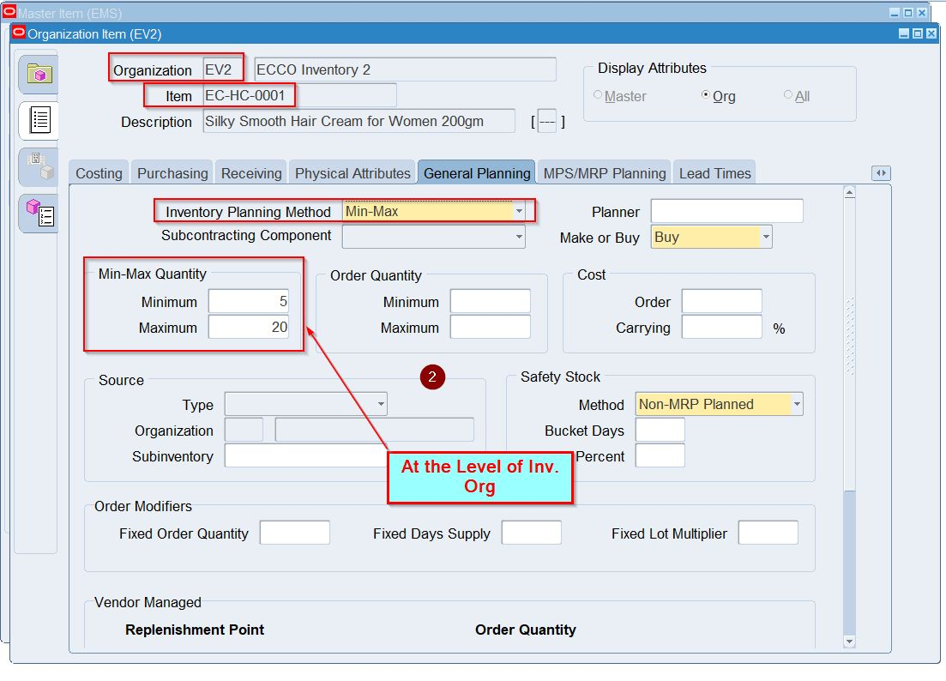
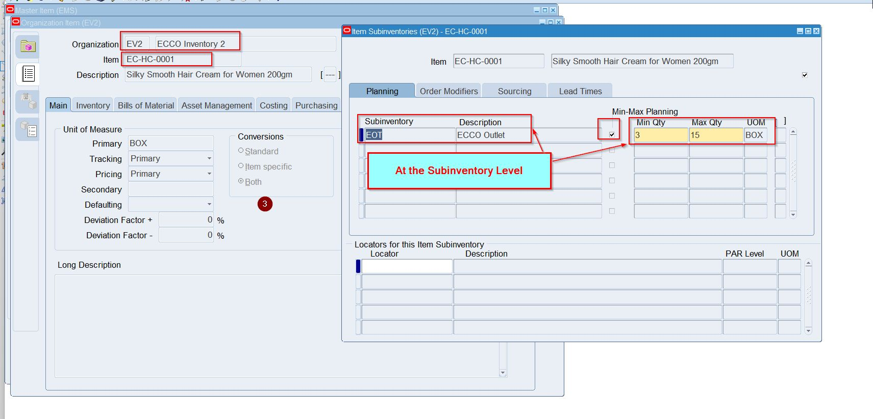

Slide 22
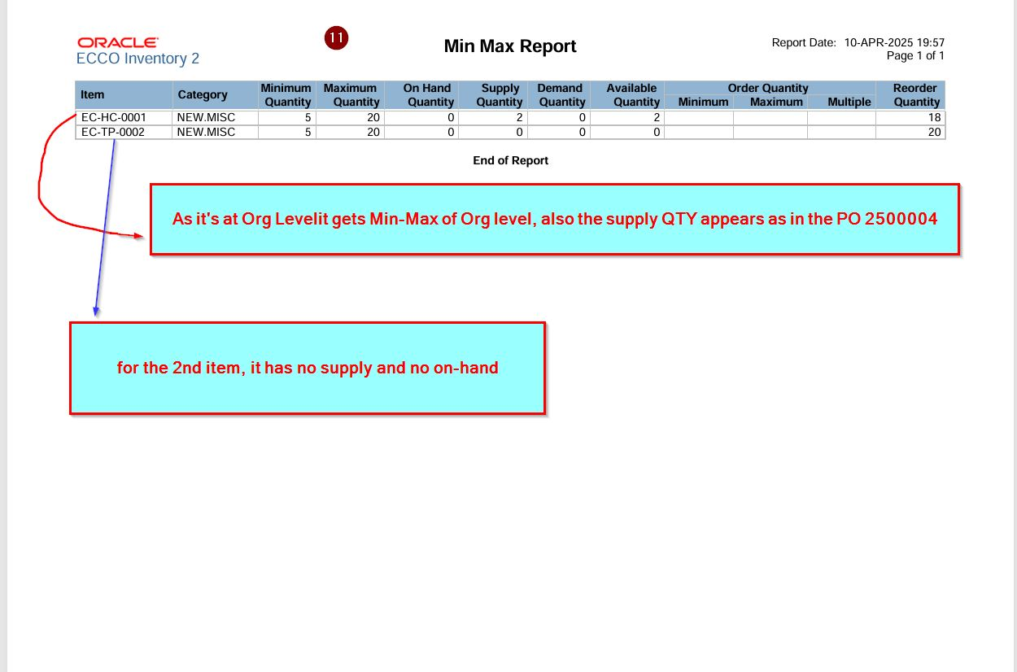
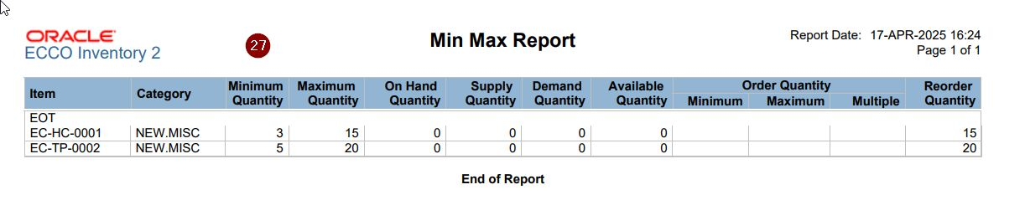
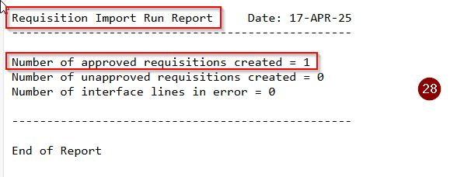
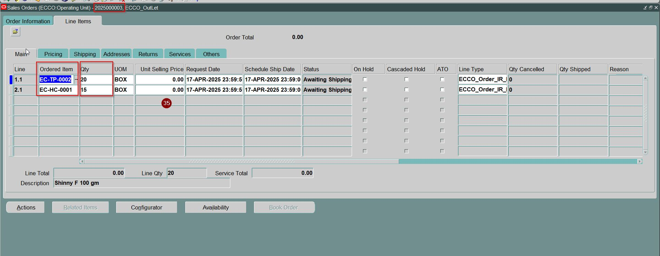
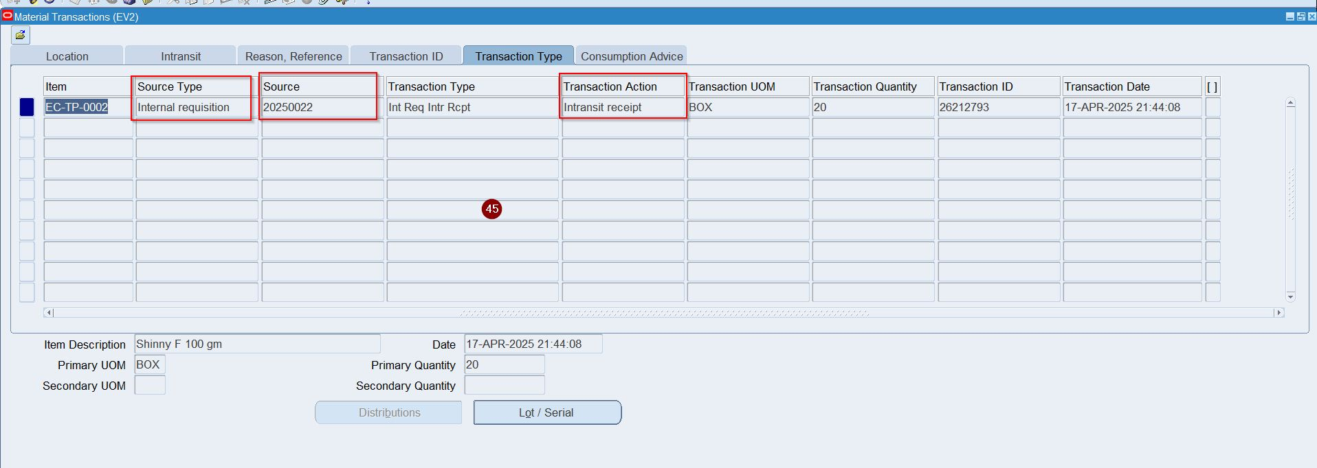

Slide 23
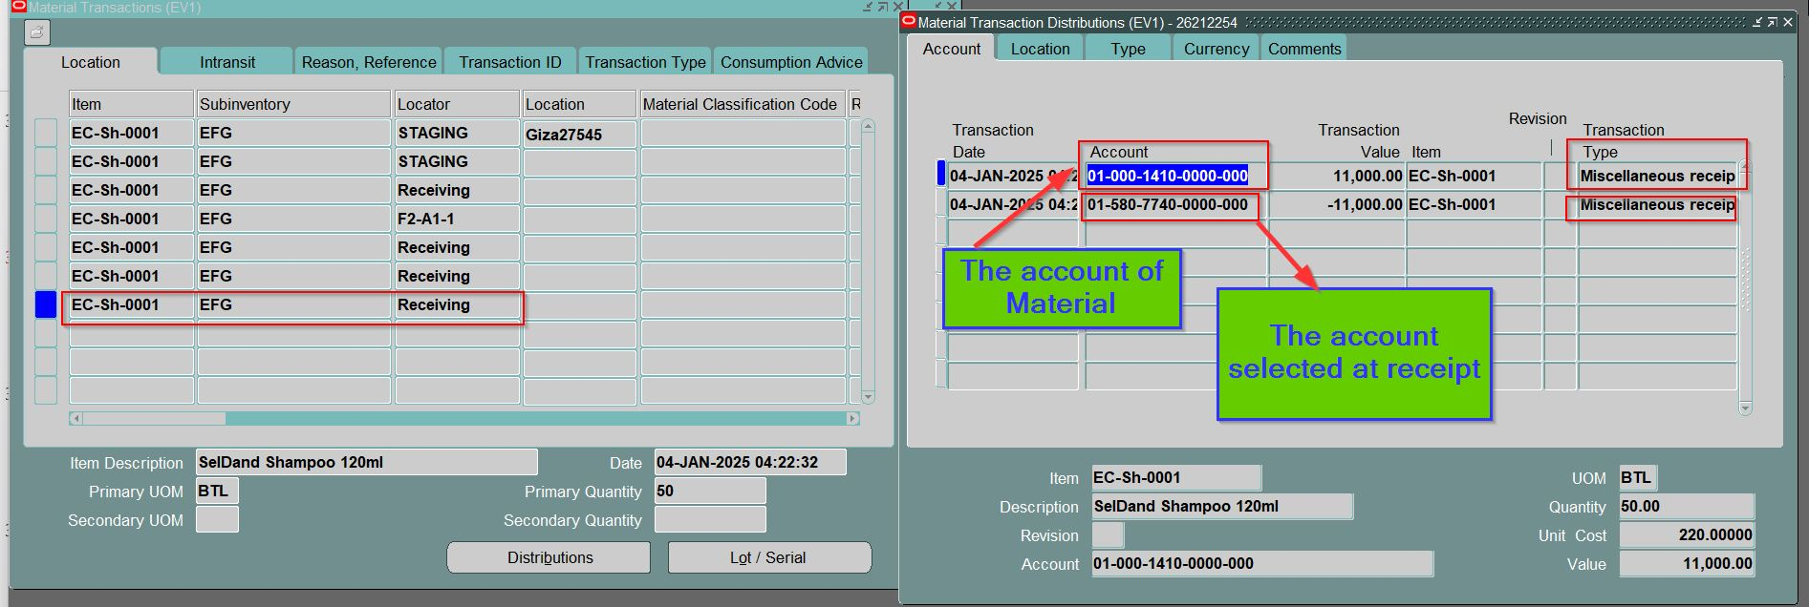
Oracle Applications - EBSDB

Slide 24
